Slide 1
FORCE-BASED PARAMETER ANALYSIS
Data of Simulation Design
ISOMAP method
Variance-based analysis
3.1. Group cohesion degree
3.1.1 ISOMAP and Pearson correlation testing
3.1.2. Residual Variance comparison between ISOMAP, MDS, PCA
3.1.3. Parameter contributing to cluster’s stability and differences
3.2. Group average speed
3.2.1 ISOMAP and Pearson correlation testing
3.2.2. Residual Variance comparison between ISOMAP, MDS, PCA
3.2.3. Parameter contributing to cluster’s stability and differences
4. Discussion
Notes:
The effect of group behaviour on crowd dynamics.-> to extract useful information (interaction between group) for evacuation plan (should escape group or alone, group by group) according to parameters of each group;
In various design layout- , flow rate average, flow rate of each group.
Discussion about which design layouts suitable, plans suit for group having maximum group cohesion, or group speed., guidance for evacuation plan
-----------------------------------------------------------------------------------------------------------------------------------------------------------------------------------------------------------------
What is data in panic situations useful for human crowd modelling? Hard because data in panic is rare, not fix. Previous studies almost investigate general data for context detection at dense place; or data in normal situation; or machine learning for abnormal behaviour detection model when disaster already happened- not for panic situations. While panic situations- group of pedestrians escape together rather escape alone), with learder or group of different ped parameter distribution. This study focuses on the instinct characteristic of group behaviour in simulations when they interact in order to extract useful information before disasters happen.
Discussion about which design layouts suitable, plans suit for maximizing group cohesion, or group speed. – Group contains pedestrians having different parameter to those of others.
The data of extracting interaction between groups in which groups have different parameters to those of others (group have maximize group cohesion, group have low speed) .
Guidance for each group evacuation; adding stochastic information dynamic context

Slide 2
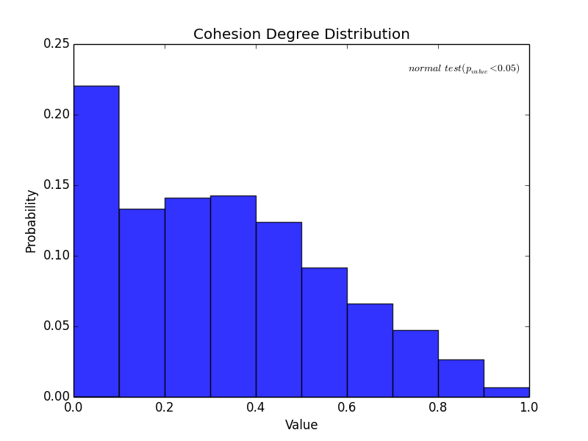
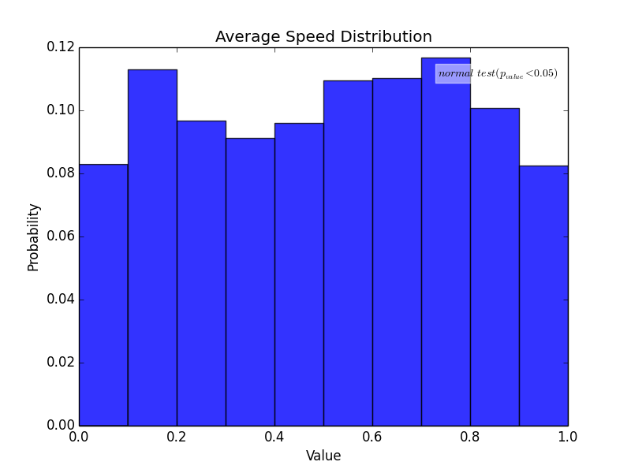
Data of Simulation Design
Distribution of group cohesion degree and average speed over 17600 model’s outputs (not normal distribution)
500 data points of each following bins are used for ISOMAP parameter analysis
min [0.0,0.1]
max [0.3,0.4]
max [0.9,1.0]
500 data points of each following bins are used for ISOMAP parameter analysis
min [0.0,0.1]
max [0.4,0.6]
max [0.8,1.0]
Notes:
After normalized

Slide 3
Isomap method
While PCA is not sufficient to cluster model’s non-linear output according to its first principal components (low explained variance), ISOmap is used to describe the manifold which is a topological space of model’s output in a lower dimension space while keeping intrinsic geometry information (preserving the shortest geodesic distance between data points).
Thus, clusters of the model’s output are then used to explain how model’s output varies according to the main interaction of which parameters.
The role of each parameter contributing to the cluster’s stability or differences is also analyzed.

Slide 4
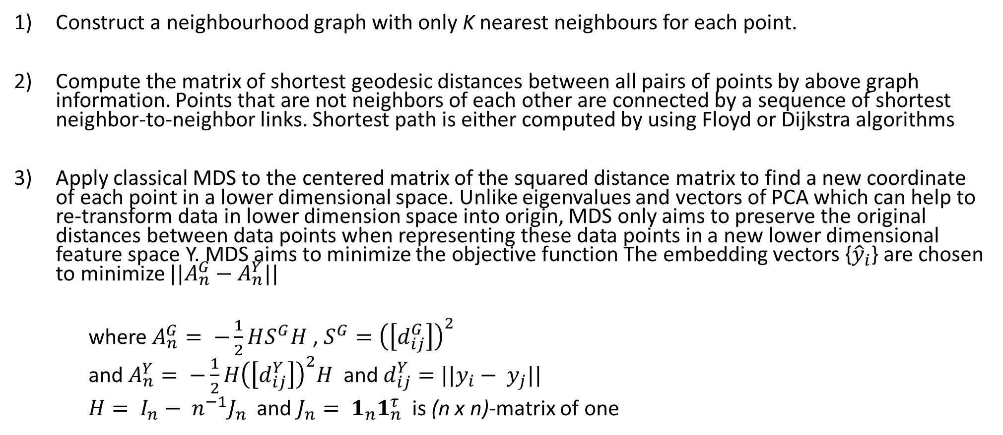
Isomap method
Construct a neighbourhood graph with only K nearest neighbours for each point.
Compute the matrix of shortest geodesic distances between all pairs of points by above graph information. Points that are not neighbors of each other are connected by a sequence of shortest neighbor-to-neighbor links. Shortest path is either computed by using Floyd or Dijkstra algorithms
Apply classical MDS to the centered matrix of the squared distance matrix to find a new coordinate of each point in a lower dimensional space. Unlike eigenvalues and vectors of PCA which can help to re-transform data in lower dimension space into origin, MDS only aims to preserve the original distances between data points when representing these data points in a new lower dimensional feature space Y. MDS aims to minimize the objective function The embedding vectors {${\hat{y}}_{i}$} are chosen to minimize ${||A}_{n}^{G}−A_{n}^{Y}||$
where $A_{n}^{G}= −\frac{1}{2}HS^{G}H$ , $S^{G}={\left(\left[d_{ij}^{G}\right]\right)}^{2}$
and $A_{n}^{Y}= −\frac{1}{2}H{\left(\left[d_{ij}^{Y}\right]\right)}^{2}H$ and $d_{ij}^{Y}=||y_{i}− y_{j}||$
$H= I_{n}− n^{−1}J_{n}$ and $J_{n}= 1_{n}1_{n}^{τ}$ is (n x n)-matrix of one

Slide 5
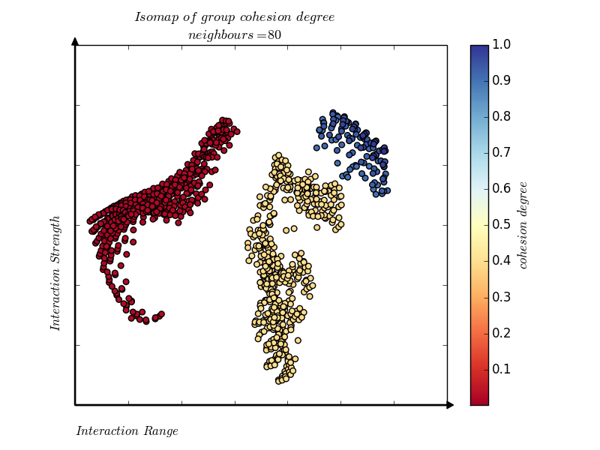
Parameter Analysis. Group cohesion degree
Pearson correlation testing:
(x-axis: Interaction Range, r = 0.86 , p-value = 0.0)
(y-axis: Interaction Strength, r = 0.72, p-value = 0.0)
Notes:
2. Describe how group cohesion degree varies according to parameters. , collinear , Correlation variables r == ??? formular > 0.7, 0.9, p -test
3. Add annotation on plot (at k = 80, datapoints)

Slide 6
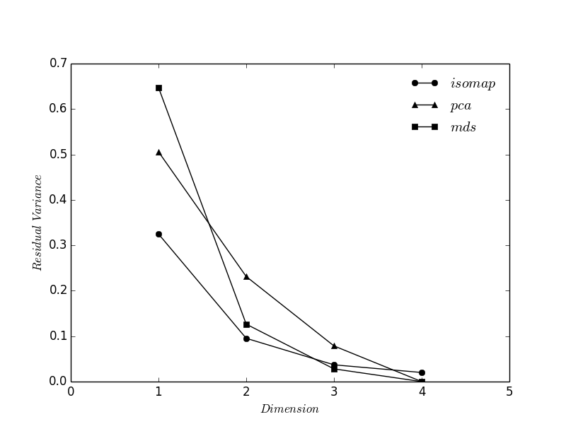
Parameter Analysis. Residual Variance
ISOMAP (neighbours = 80) at 2 dimensions yields the lowest residual variance that could not be represented, 9%, compared to other methods.
Notes:
1.Plot-Variance between residual variance between ISOMAP (formular) (n dimensional), compare to PCA, MDS - "elbow" in the curve

Slide 7
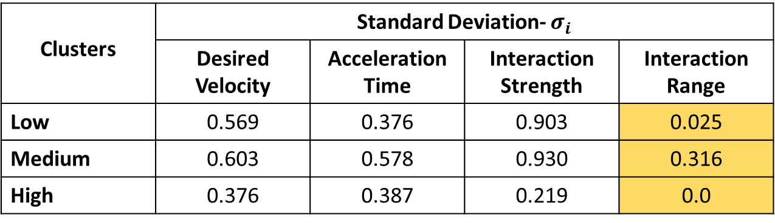
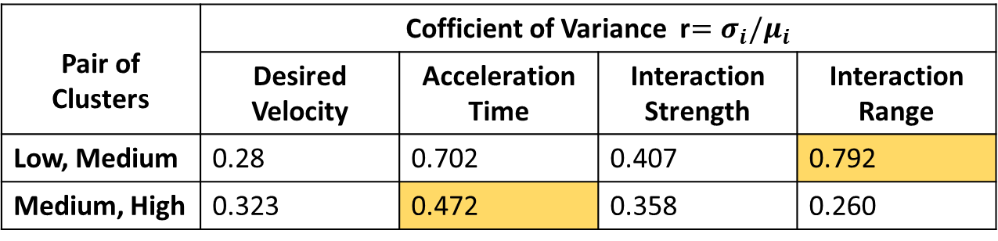
Parameter Analysis. Group cohesion degree
Which parameters support to discriminate groups of objects?
Clusters | Standard Deviation- $σ_{i}$
 | Desired Velocity | Acceleration Time | Interaction Strength | Interaction Range
Low | 0.569 | 0.376 | 0.903 | 0.025
Medium | 0.603 | 0.578 | 0.930 | 0.316
High | 0.376 | 0.387 | 0.219 | 0.0
Interaction Range’s contribution is consistent in each cluster
Pair of Clusters | Cofficient of Variance r$=σ_{i}/μ_{i}$
 | Desired Velocity | Acceleration Time | Interaction Strength | Interaction Range
Low, Medium | 0.28 | 0.702 | 0.407 | 0.792
Medium, High | 0.323 | 0.472 | 0.358 | 0.260
Interaction Range performs good discrimination from low to medium values
To achieve highest group cohesion from medium value, acceleration time varies the most
Notes:
.Apply cluster algorithm is then applied to the output of MDS to determine clusters of variables
Standard Deviation of each parameter at each group. Smaller values indicate species contribution is consistent across all pairs of objects
Calculate average δi over all pairs of objects between groups. Larger values indicate species contribute more to group differences
Calculate ratio of δi/ SD(δi), Larger values indicate good discriminating species between 2 groups
Group cohesion degree when interaction range highest and and acceleration time is , compare three values (0.792, 1.2966, 0.472)

Slide 8
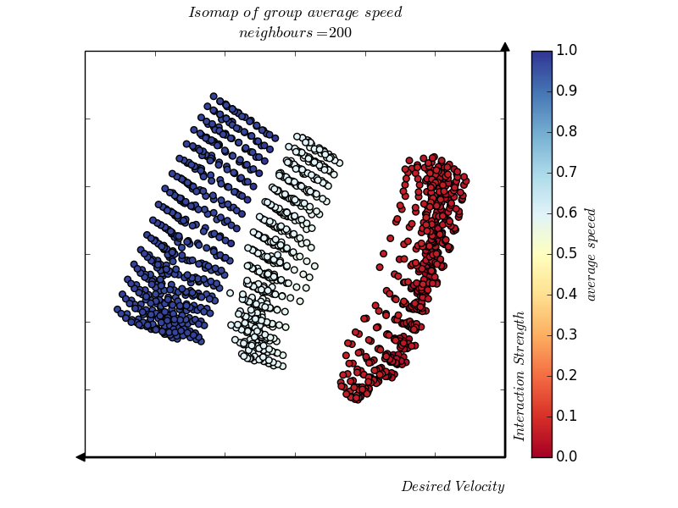
Parameter Analysis. Group average speed
Pearson correlation testing:
(x axis-:Desired Velocity, r = -0.954, p-value = 0.0)
(y-axis: Interaction Strength, r = 0.902, p-value = 0.0)

Slide 9
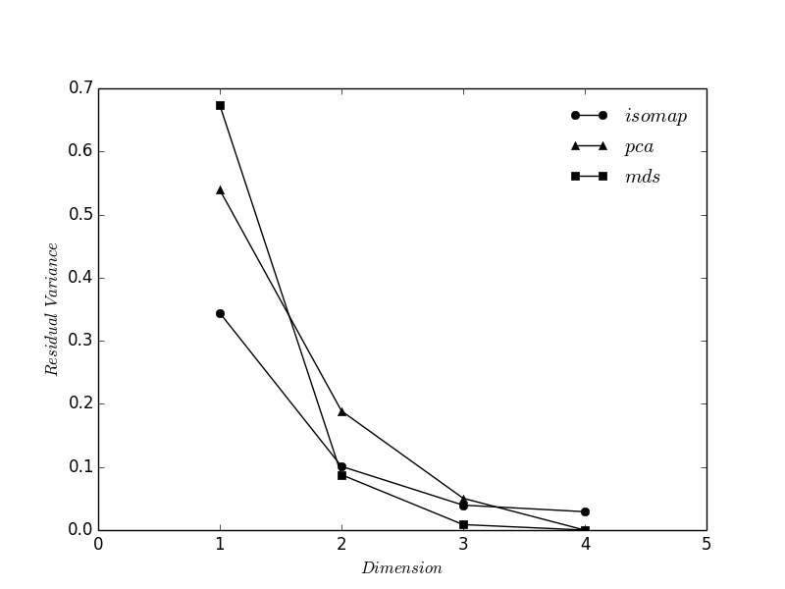
Parameter Analysis. Group average speed
ISOMAP (neighbours = 200) at 2 dimensions yields the same residual variance value to MDS method, which is 9%, compared to PCA method.

Slide 10
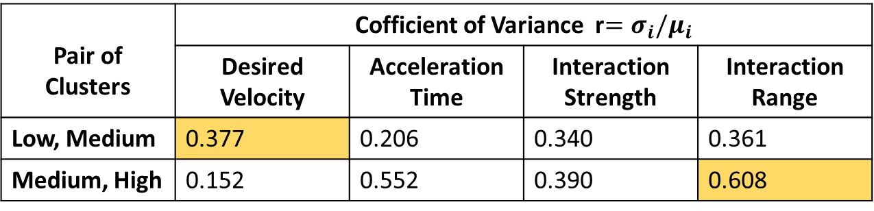
Parameter Analysis. Group average speed
Which parameters support to discriminate groups of objects?
Clusters | Standard Deviation- SD(δi)
 | Desired Velocity | Acceleration Time | Interaction Strength | Interaction Range
Low | 0.015 | 0.295 | 0.855 | 0.431
Medium | 0.04 | 0.324 | 0.910 | 0.504
High | 0.00 | 0.561 | 0.937 | 0.549
Desired Velocity’s contribution is consistent in each cluster
Pair of Clusters | Cofficient of Variance r$=σ_{i}/μ_{i}$
 | Desired Velocity | Acceleration Time | Interaction Strength | Interaction Range
Low, Medium | 0.377 | 0.206 | 0.340 | 0.361
Medium, High | 0.152 | 0.552 | 0.390 | 0.608
Desired velocity perform good discrimination from low to medium value of group average speed
To achieve high group speed from medium, Interaction Range varies the most
Notes:
3. Apply cluster algorithm is then applied to the output of MDS to determine clusters of variables
HIGHEST group average speed when desired velocity high and then interaction increase will make ped follow, make ped easier go less repulsive force

Slide 11
Discussion
Findings
Group cohesion degree:
depends on Interaction Range
moving from medium value to high value of group cohesion degree, acceleration time varies the most
Group average speed:
depends on Desired Velocity
moving from medium value to high value of group speed, interaction range varies the most
Further work
Sensitivity analysis (Sobol, Morris, FAST)
Constraint to reach high/medium/low values of group cohesion degree and speed
Design experiment scenarios based on Interaction Strength, Interaction Range, and Desired Speed to evaluate group information
Data in panic situation
Pedestrians in panic situation escape by group rather than individual. Data (e.g. crowd pressure, flowrate) when different groups interact in evacuation scenarios are used to enhance crowd models in macro level
Notes:
3. Apply cluster algorithm is then applied to the output of MDS to determine clusters of variables
Different group (V, S, RANGE) interact

Slide 12
The Spearman correlation coefficient is the non-parametric equivalent of the Pearson correlation coefficient. It similarly takes values between -1 and +1, the difference is that it quantifies the extent to which the variables tend to increase or decrease together ie. the extent to which one variable tends to increase as the other increases. A value of zero indicates no such tendency. The Pearson correlation only assesses linear association. A Pearson correlation of 1 or -1 will also yield exactly the same values. However a Spearman correlation of + or -1 can occur where the Pearson correlation is nearer to zero. For example:. The Spearman correlation coefficient is equivalent to the Pearson correlation of the ranks.
Notes:
https://epilab.ich.ucl.ac.uk/coursematerial/statistics/non_parametric/spearman.html

Slide 13
Pearson's correlation is a measure of the linear relationship between two continuous random variables. It does not assume normality although it does assume finite variances and finite covariance. When the variables are bivariate normal, Pearson's correlation provides a complete description of the association.
Spearman's correlation applies to ranks and so provides a measure of a monotonic relationship between two continuous random variables. It is also useful with ordinal data and is robust to outliers (unlike Pearson's correlation).
The distribution of either correlation coefficient will depend on the underlying distribution, although both are asymptotically normal because of the central limit theorem.
Notes:
https://epilab.ich.ucl.ac.uk/coursematerial/statistics/non_parametric/spearman.html

Slide 14
Pearson's correlation
Spearman's Rho correlation
Kendall's tau
->Pearson's correlation on raw variables is misleading.
Outliers: Outliers can have great influence on Pearson's correlations. Many outliers in applied settings reflect measurement failures or other factors that the model is not intended to generalise to. One option is to remove such outliers. Univariate outliers do not exist with Spearman's rho because everything is converted to ranks. Thus, Spearman is more robust.
Highly skewed variables: When correlating skewed variables, particularly highly skewed variables, a log or some other transformation often makes the underlying relationship between the two variables clearer (e.g., brain size by body weight of animals). In such settings it may be that the raw metric is not the most meaningful metric anyway. Spearman's rho has a similar effect to transformation by converting both variables to ranks. From this perspective, Spearman's rho can be seen as a quick-and-dirty approach (or more positively, it is less subjective) whereby you don't have to think about optimal transformations.
Notes:
http://www2.warwick.ac.uk/fac/sci/moac/people/students/peter_cock/python/rank_correlations/
http://stats.stackexchange.com/questions/3730/pearsons-or-spearmans-correlation-with-non-normal-data
http://www2.warwick.ac.uk/fac/sci/moac/people/students/peter_cock/python/rank_correlations/
scipy.stats.stats.rankdata(x)

Slide 15
The Spearman correlation is a nonparametric measure of the monotonicity of the relationship between two datasets. Unlike the Pearson correlation, the Spearman correlation does not assume that both datasets are normally distributed. Like other correlation coefficients, this one varies between -1 and +1 with 0 implying no correlation. Correlations of -1 or +1 imply an exact monotonic relationship. Positive correlations imply that as x increases, so does y. Negative correlations imply that as x increases, y decreases.

